Slide 1
Hello every one !!!

Slide 2
WARM-UP: JUMBLED WORDS
MEANS OF TRANSPORT
1- OTBA ->
2- ITANR ->
3- NPEILAPRA ->
4- RSOTRPCA ->
5- OTMIROEKB ->
BOAT
TRAIN
AIRPLANE
SPORT CAR
MOTORBIKE

Slide 3
Unit
7
TRAFFIC
LESSON 2: A CLOSER LOOK 1
VOCABULARY
PRONUNCIATION
HOBBIES

Slide 4
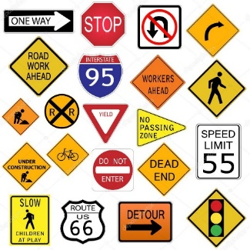
* VOCABULARY
- road sign (n):
/ˈrəʊd saɪn/
Biển báo giao thông

Slide 5
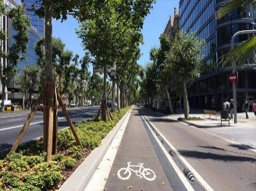
- cycle lane (n):
/ˈsaɪkl leɪn/
Làn đường dành riêng cho xe đạp

Slide 6
- -traffic lights:
/ˈtræfɪk laɪt/
ĐÈN GIAO THÔNG

Slide 7
- Crossroads (n):
/ˈkrɒsrəʊdz/
Ngã tư

Slide 8
- Pavement (n) :
/ˈpeɪvmənt/
vỉa hè
(Footpath)

Slide 9
New words | Pronunciation | Meaning
1. road sign (n) | /ˈrəʊd saɪn/ | biển báo giao thông
2. cycle lane (n) | /ˈsaɪkl leɪn/ | làn đường dành riêng cho xe đạp
3. traffic light (n) | /ˈtræfɪk laɪt/ | đèn giao thông
4. Crossroads (n) | /ˈkrɒsrəʊdz/ | ngã tư
5. Pavement (n) | /ˈpeɪvmənt/ | vỉa hè

Slide 10
* Checking vocab
say words in English
Ngã tư
road sign
Crossroads
Biển báo giao thông
Đèn giao thông
traffic light
Vỉa hè
Pavement
Làn đường dành cho
xe đạp
cycle lane

Slide 11
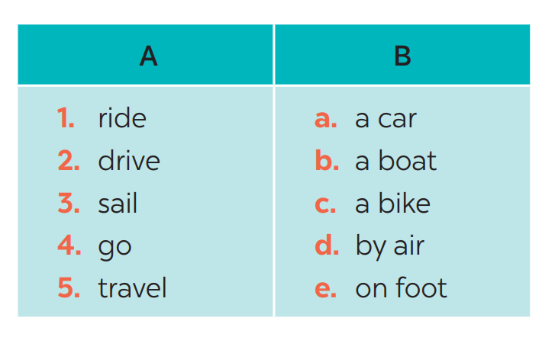
* VOCABULARY
1
Match the words in A with the phrases in B.
1. c
2. a
3. b
4. e
5. d

Slide 12
* VOCABULARY
1
Make your own sentences with these phrases.
My father taught me how to ride a bike.
My father usually drives a car to work.
Visitors I can sail a boat in Ha Long Bay.
I sometimes go on foot to school.
Nowadays, people can travel by air to
anywhere in the world
- drive a car
- ride a bike
- sail a boat
- go on foot
- travel by air

Slide 13
* VOCABULARY
2
Look at these road signs. Then write the correct phrases under the signs.
traffic lights
Hospital ahead
No right turn
cycle lane
School ahead
No cycling

Slide 14
* VOCABULARY
3
Work in pairs. Take turns to say which of the signs in 2 you see on the way to school.
A: On the way to school, there are crossroads, so I see several traffic lights.
B: On my way to school, there is a school, so I see a “school ahead sign”.
….

Slide 15
* PRONUNCIATION
/aɪ/ and /eɪ/

Slide 16
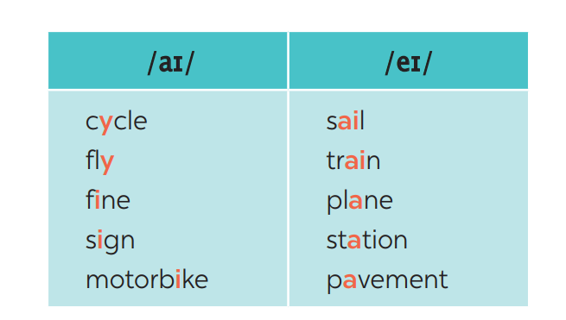
* PRONUNCIATION
4
Listen and repeat. Pay attention to the sounds /aɪ/ and /eɪ/.

Slide 17
* PRONUNCIATION
5
Underline the words with the sound /aɪ/ and circle the words with the sound /eɪ/. Then listen, check and repeat
1. The bus station is far from my house.
2. Remember to ride your bike carefully.
3. We must obey traffіc rules for our safety.
4. You have to get there in time for the train.
5. Don’t ride on the pavement.

Slide 18
* CONSOLIDATION
VOCABULARY
PRONUNCIATION

Slide 19
homework
- Do exercises in the workbook.
- Prepare lesson 3 (A closer look 1)

Slide 21
Cần hỗ trợ, Thầy/Cô liên hệ Zalo: 034.989.5579

